Slide 1
Book publishing house website
My first website
Milo Masoničić

Slide 2
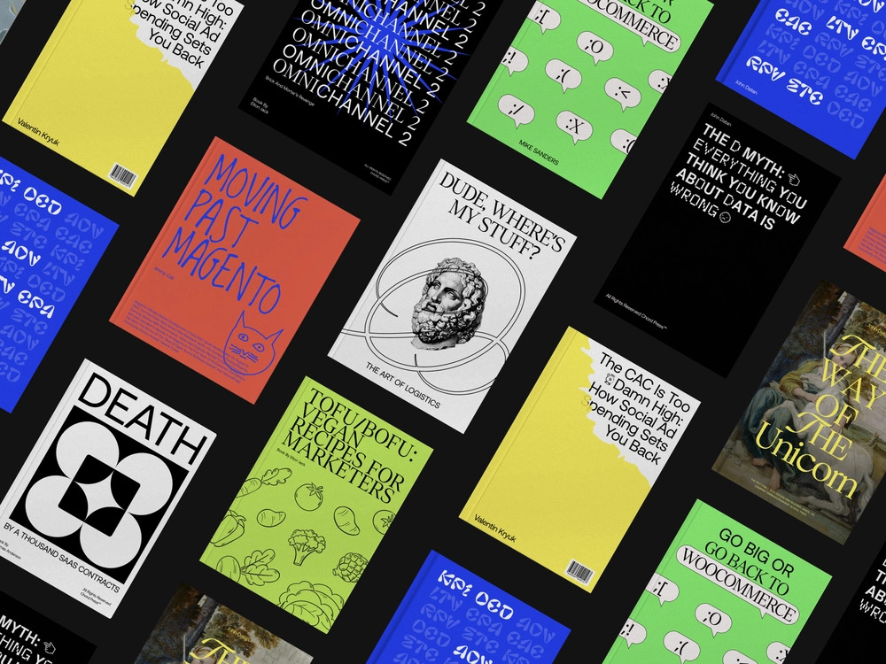
Why I chose to make website for a indie publishing house?
Love for books and cd cover art
Potential for an interesting web-design inspired by book covers and graphic design

Slide 3
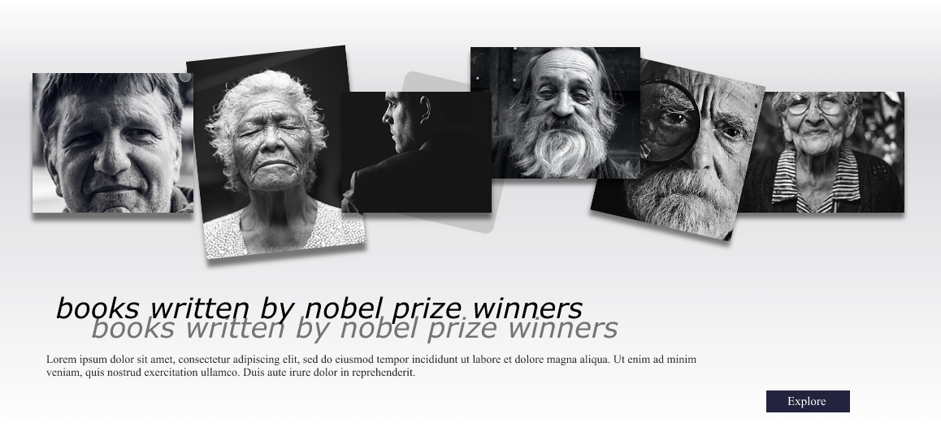
Working process
Low fidelity wireframe
Moodboard
Color palette and images
High fidelity wireframe
Programming

Slide 4
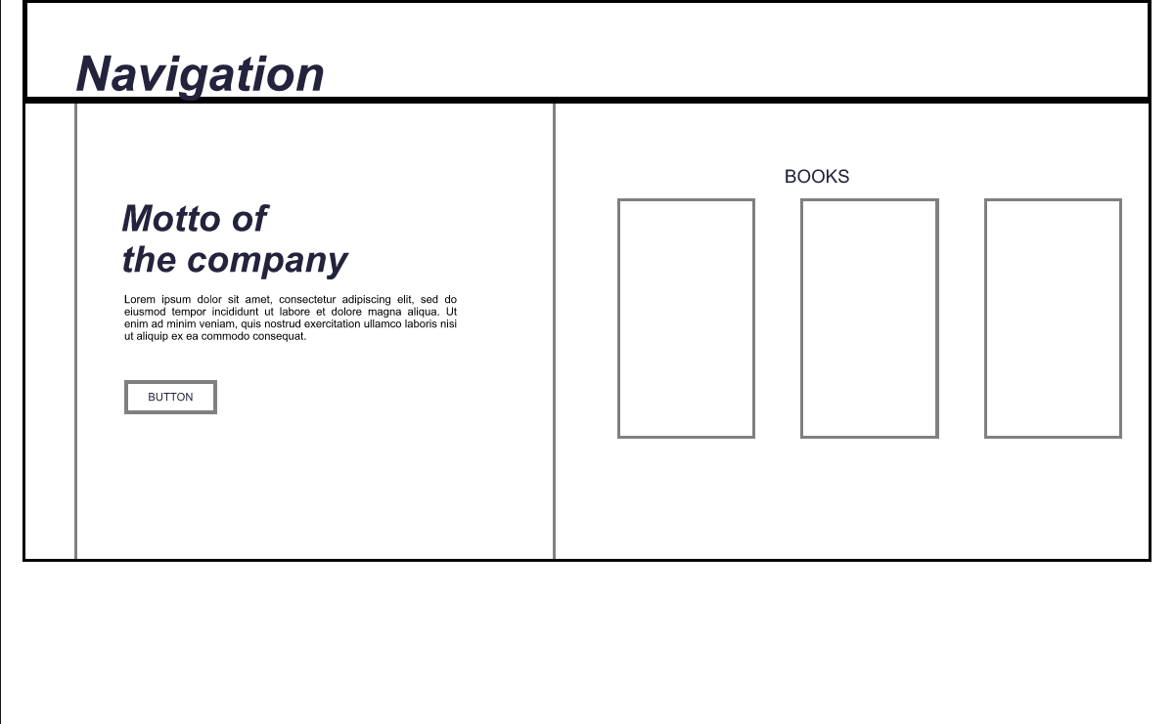
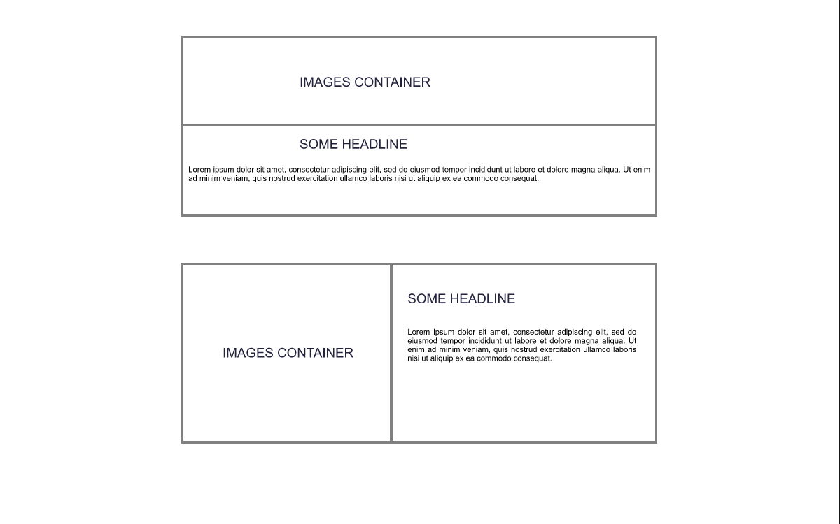
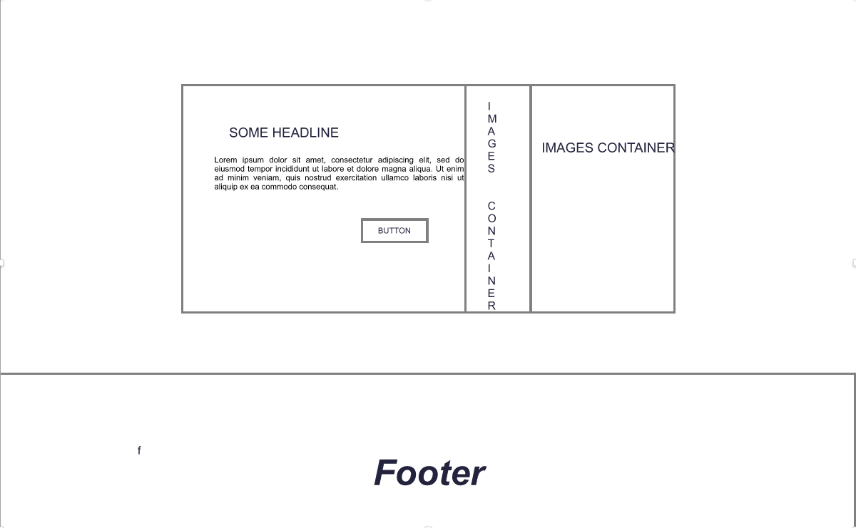
Low fidelity wireframe of landing page
First screen
Second screen
Third screen

Slide 5
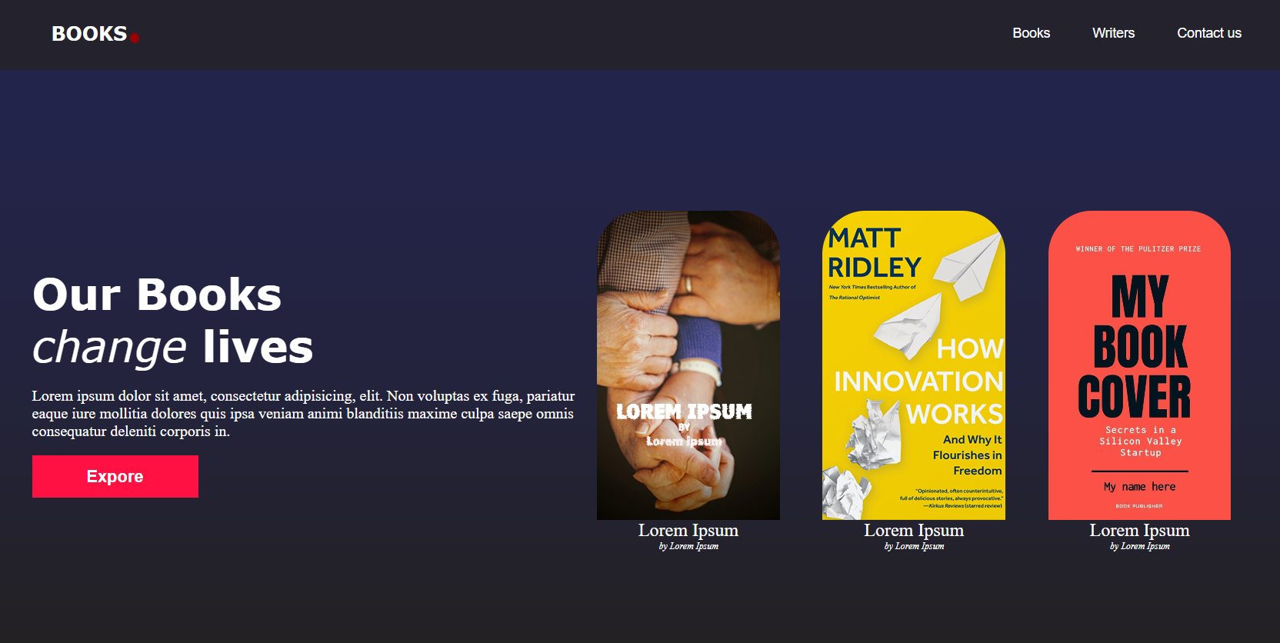
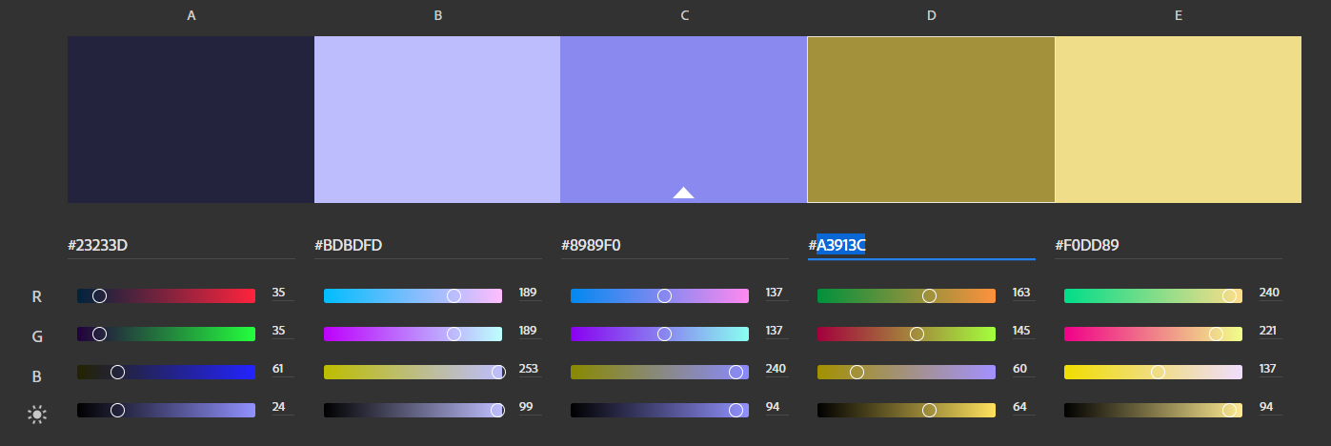
Color palette
Considered using complementary color palette
Decided to use 3 color
linear gradient instead
background-image: linear-gradient(#23244d, #23233d, #23211d)

Slide 6

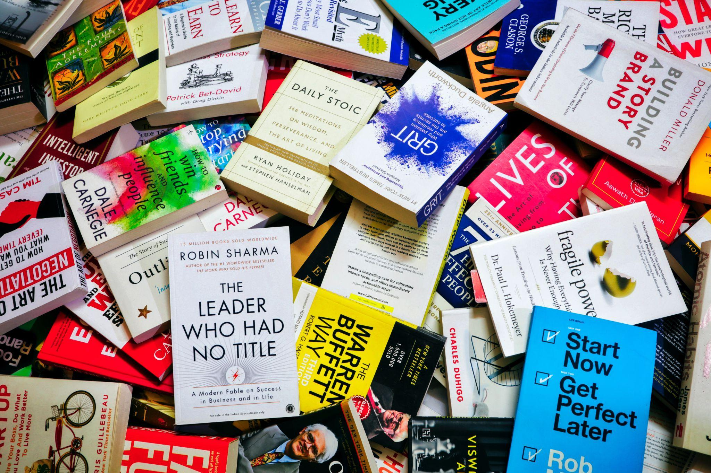
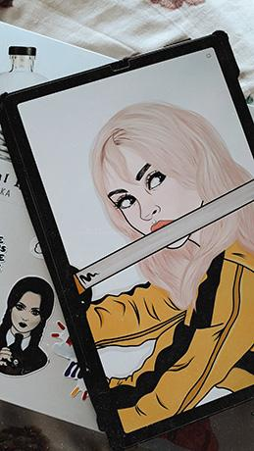



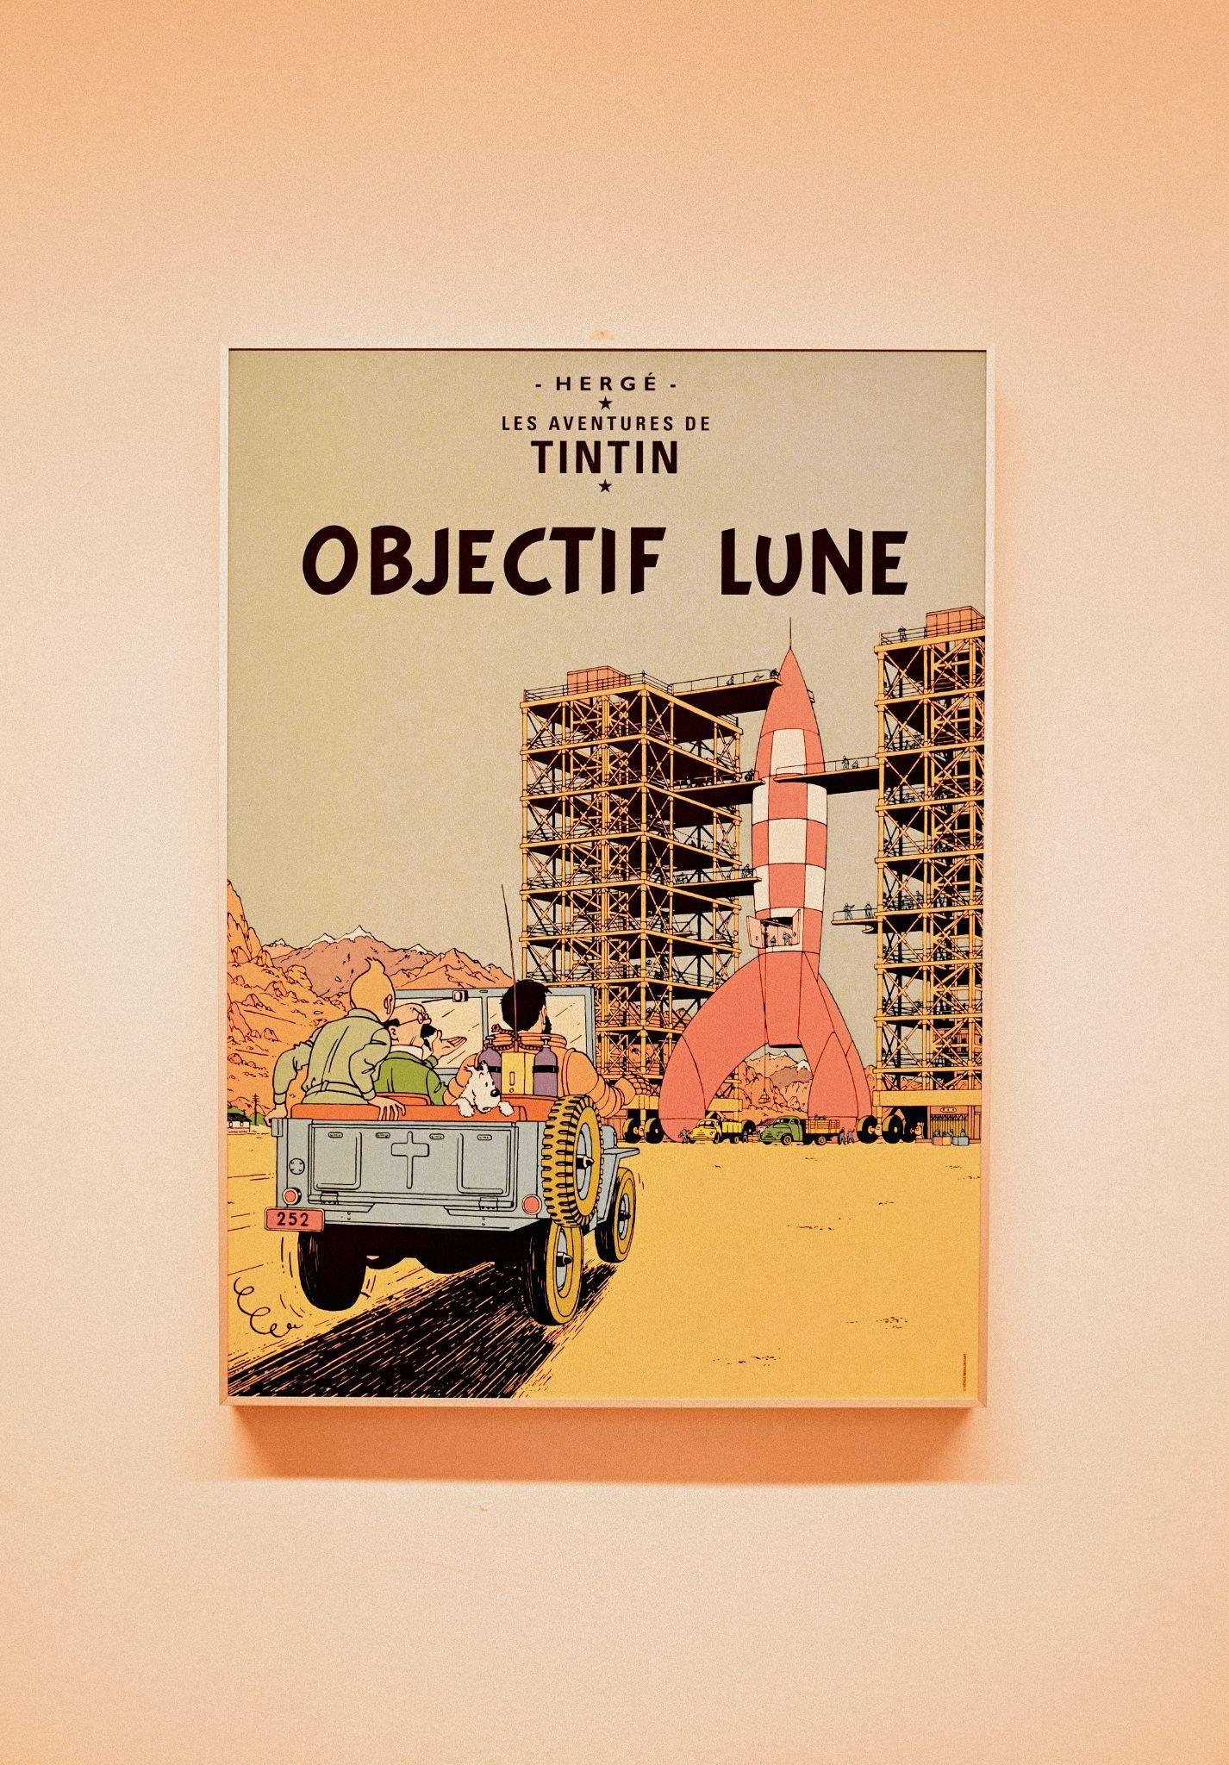
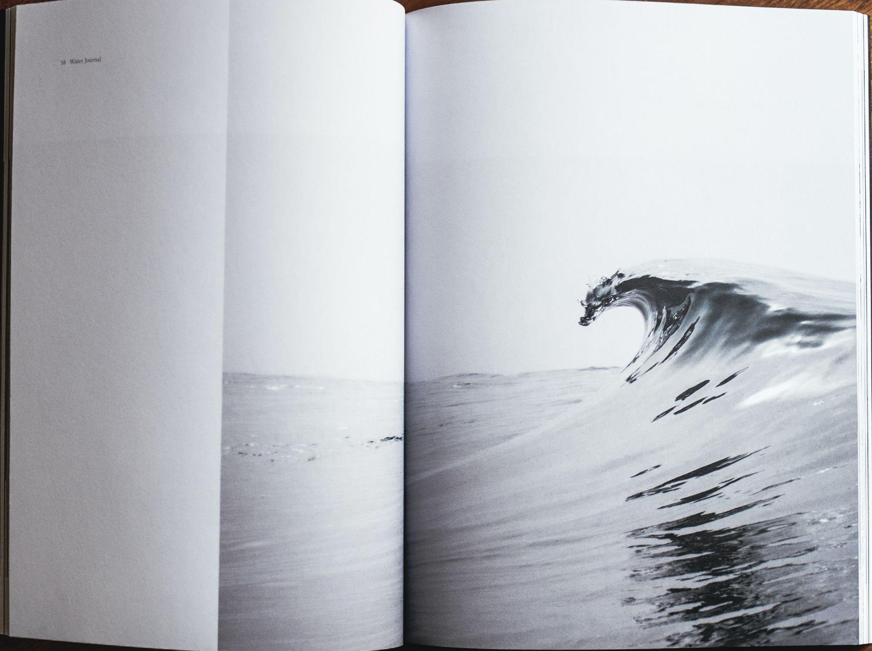
Moodboard
And some images
Used for the website

Slide 7
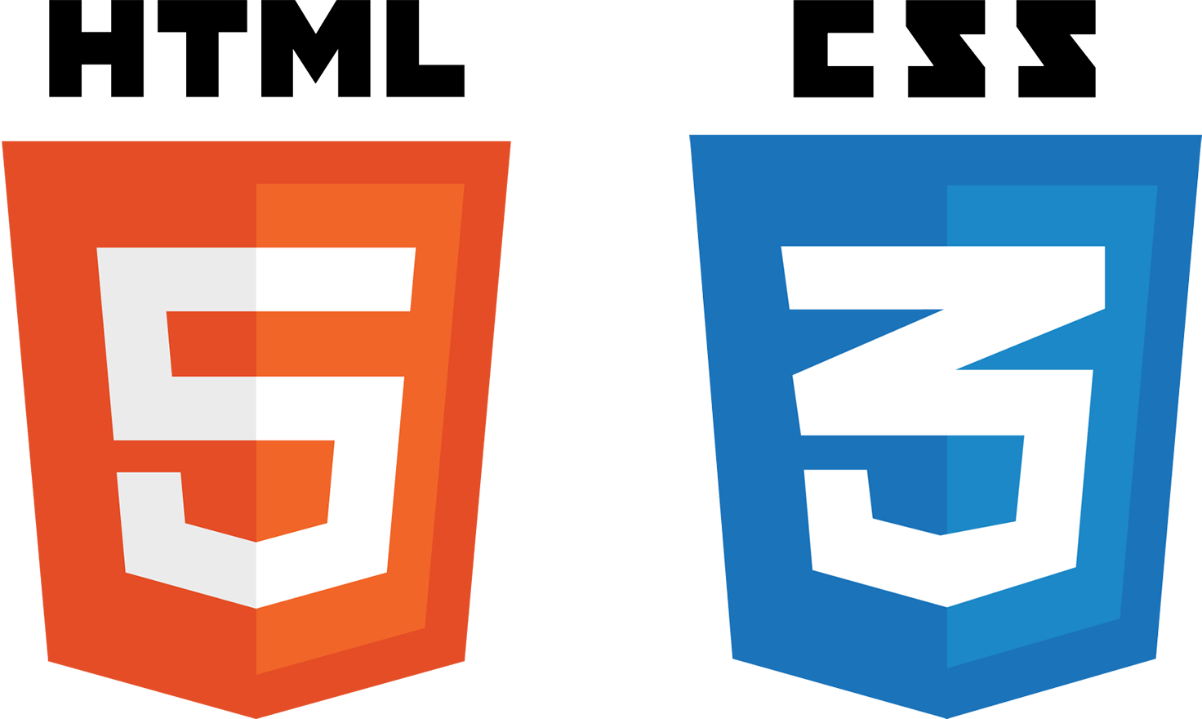
Important programming concepts
Box model
Flex and grid layouts
Media queries and breaking points

Slide 8
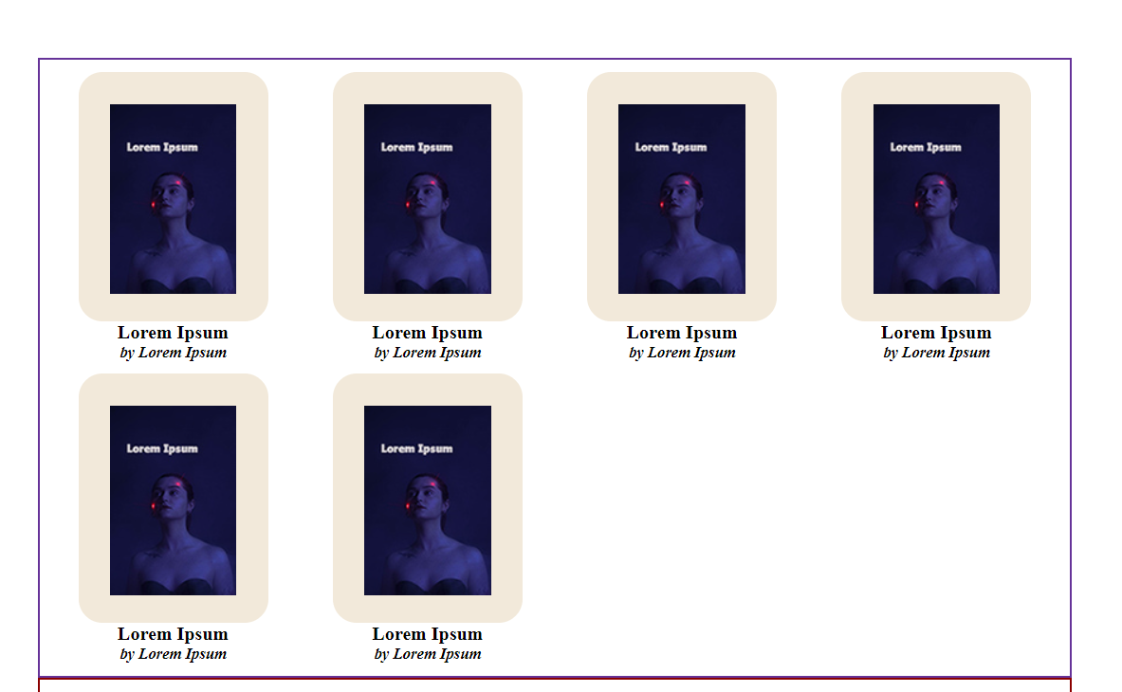
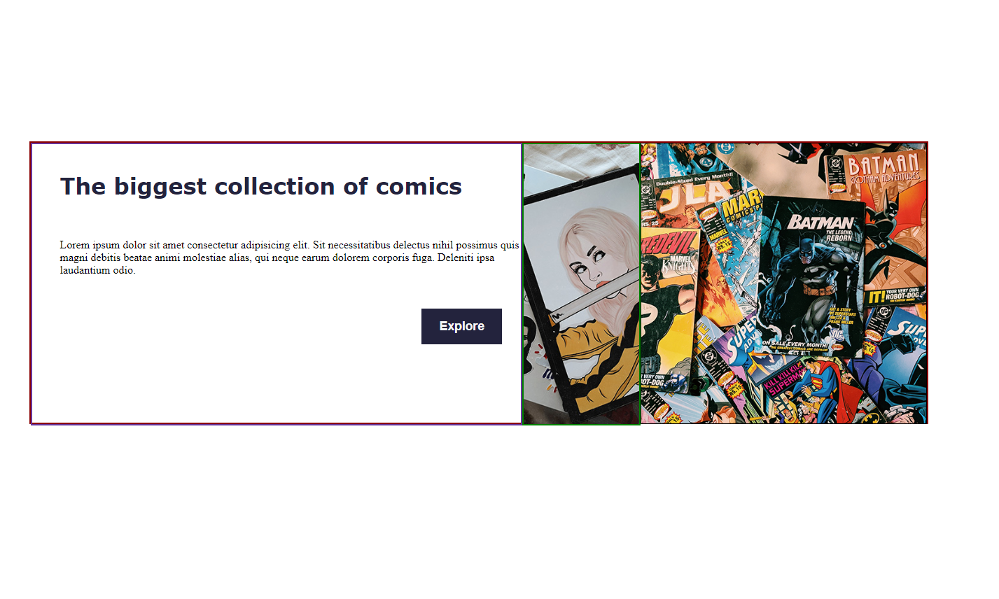
GRID CONTAINER
FLEX CONTAINER
.popularBooks {
margin-top: 220px;
width: 80%;
padding: 10px;
display: grid;
grid-gap: 20px;
grid-template-columns: repeat(6, 1fr);
}
.comics {
margin-top: 150px;
width: 80%;
height: 400px;
display: flex;
border: 2px solid darkred;
}

Slide 9
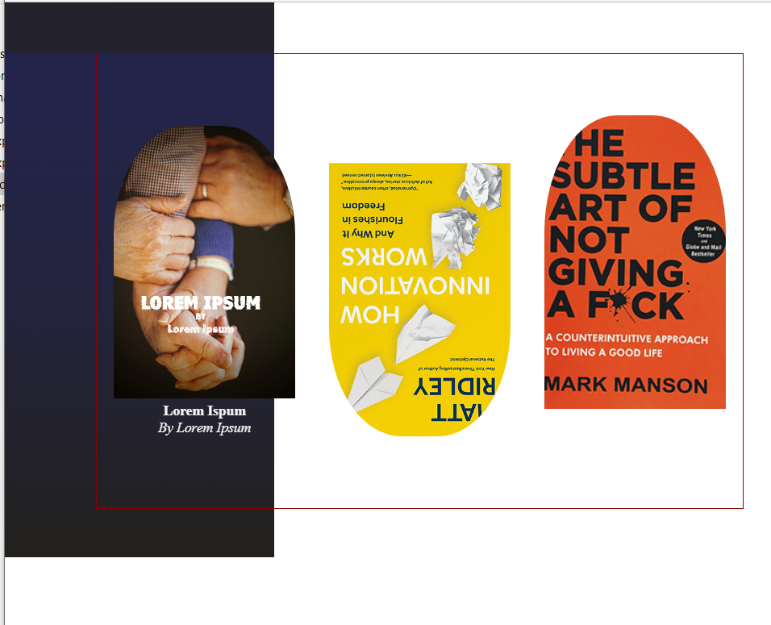
Overflow and horizontal scroll
Potential reasons:
Not using max and min width
Padding of elements
Position relative
Potential solution:
Avoiding absolute dimensions
Not forgetting that the width property in CSS targets the width of the element's content area, but the actual width is content area + padding + border if box sizing is not set to border-box

Slide 10
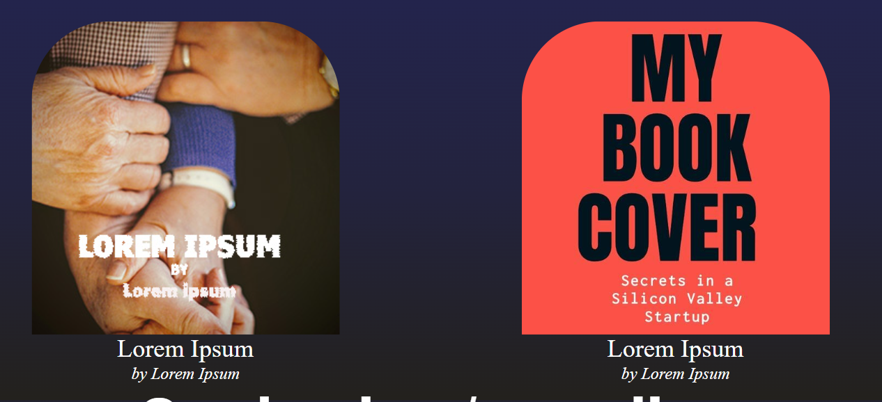
Object-fit property and div height
Giving relative value of
100% to height property of image wrapper div can cause problems displaying image which is not used as background image
Notes:
Cover value + width:100% + height:100% is good solution for background images
Contain + width set in % is good solution for other images

Slide 11
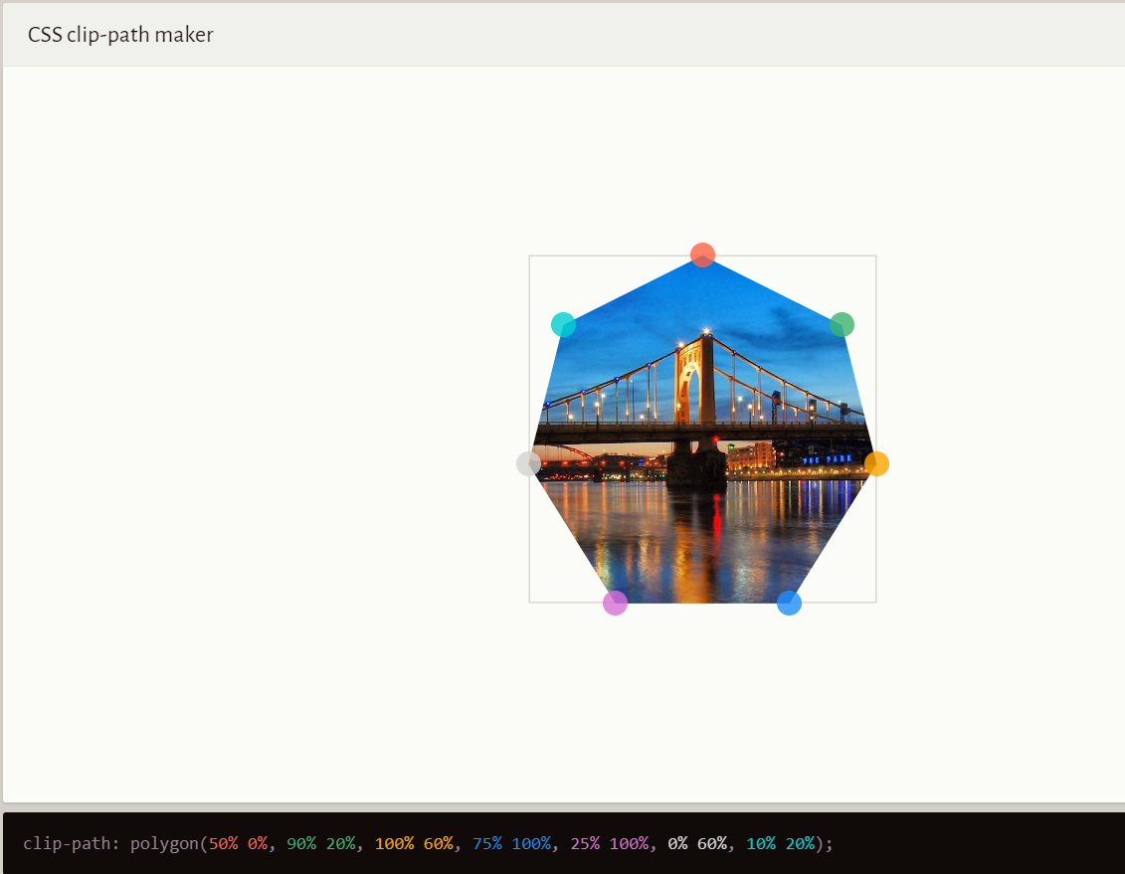
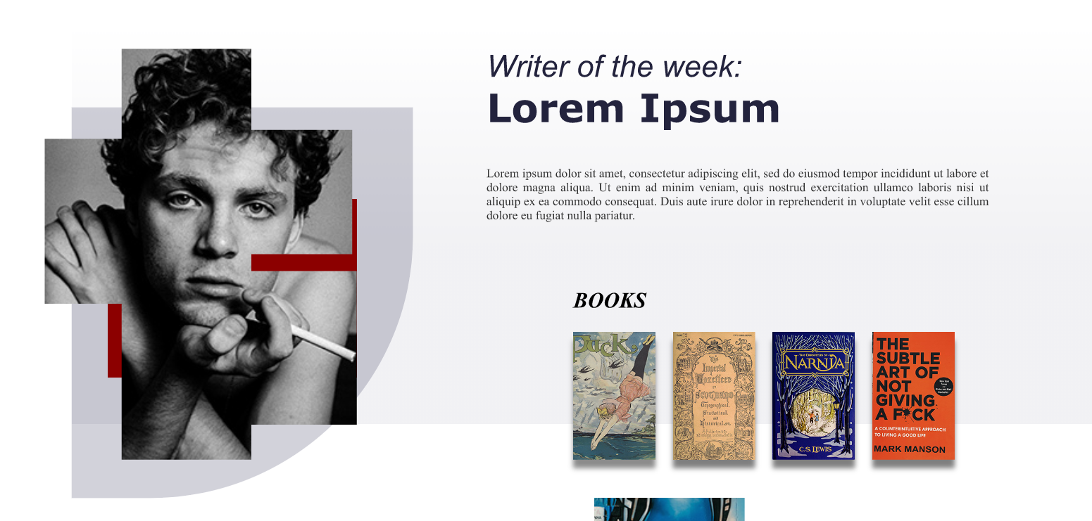
Clip path - an interesting property
Property that helps us make unexpected shapes
https://bennettfeely.com/clippy/ (Bennettfeely website)

Slide 12
Project Timeline
Third stage/Current stage
1,Fixing errors that led to the overflow
2.Making site fully responsive
First stage
Design of the web site.
06.12.2022
20.12.2022
01.12.2022
12.12.2002
Second stage
Programming for the wide screen
Final stage/Next stage
Analyzing the project (.taking care of consistency, adding links, fixing cosmetic errors)

Slide 13
Conclusion:
This project taught me that, in programming and web design, there are many solutions to one problem. Having clear idea about website is road to success.

